Slide 1
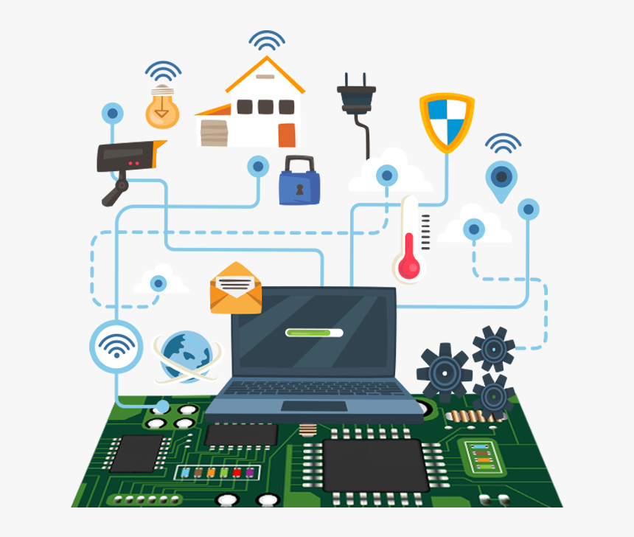
IoT based smart energy management system
Code : B21PB02 || UG4 ECE
Guide : Dr. Paul Braineard
Group details :
T. Charan Reddy - S20180020254
S. Sai Jyothi Kumar - S20180020250

Slide 2

Synopsis
Our main focus is to analyze power usage and manage devices using IoT .
We achieve this using sensors, actuators, micro controllers and a website.
Arduino & Raspberry pi are used as microcontrollers.
We created remote management & infographics using website.
Remote control of intensity of a bulb using website.

Slide 3

Work Preview
1st evaluation
2nd evaluation
3rd evaluation
Final evaluation
About Project.
Sensors and modules.
Methodology & concerns.
Designed a website.
Thingspeak for input data.
SQL database
Serial communication
Working switches.
Dataflow through raspberry pi & thingspeak.

Slide 4
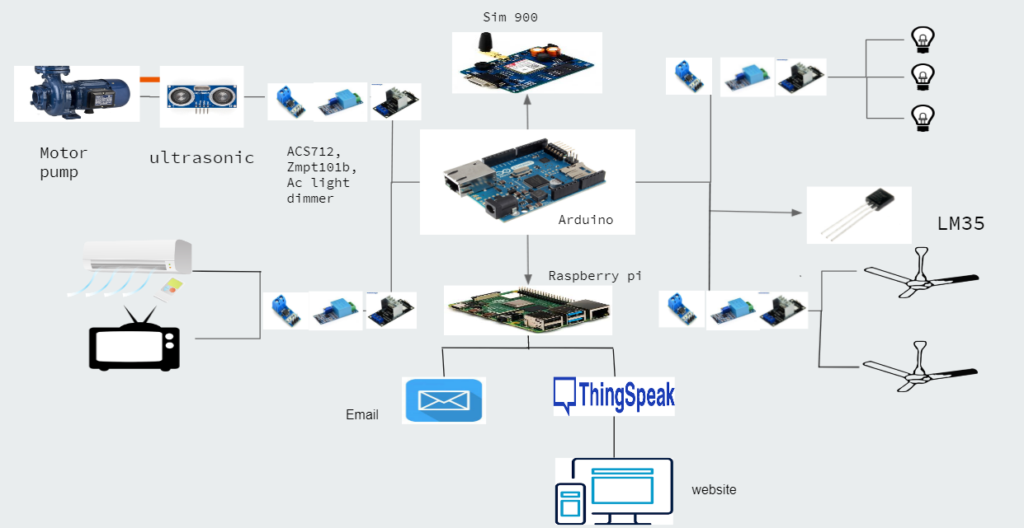

Slide 5

Work done
Integration of Dataflow through Arduino, Raspberry pi, thingspeak & website.
Calculation of Power bill based on power scaling slabs and send it via mail and text message.
Intensity control & data transfer through website is done by Django framework in thingspeak.
Website contains device feedbacks, Power consumption graphs & other features.
Hosting website online using Ngrok

Slide 6
In Arduino,
We defined variables, pins & baud rate for communication.
Message function for GSM, trig & echo for ultrasonic sensor has been included based on requirements.
serial.available to check inputs from raspberry pi.
We calculated current & voltages from sensors 10 times & calculated average value for use.
For further processing to raspberry pi, we generated the entire data such as power measurement, switch positions in arduino.

Slide 7
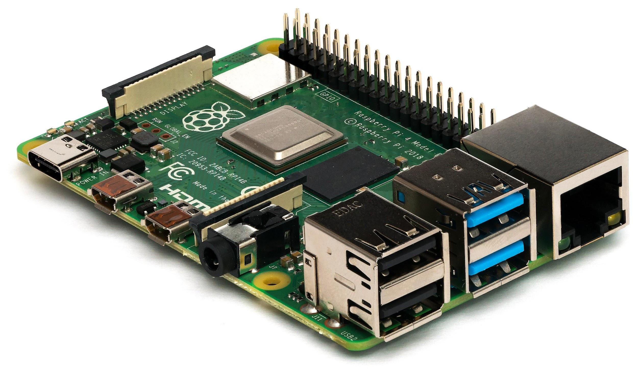
In Raspberry pi,
We imported modules like requests, time, yagmail etc.
Serial communication is established using USB and we initialize timer.
Mailing function is used to send power consumption details to user.
Units consumed by user is calculated using instantaneous power from arduino and time taken and data is uploaded to thingspeak.

Slide 8
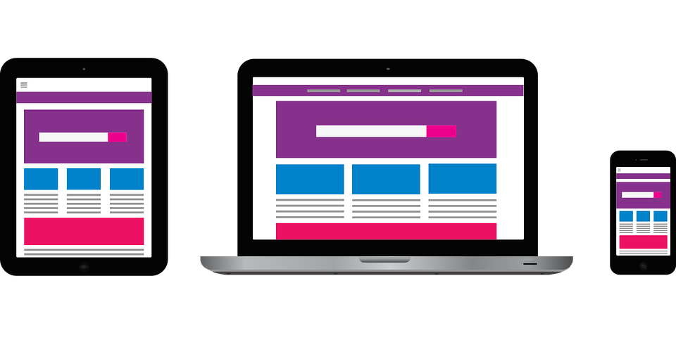
Thingspeak & Ngrok
Thingspeak is an IoT analytics platform used to transfer live data through cloud.
We created 3 Rooms with 8 fields for options like ON/OFF, intensity control, power consumption etc.
Ngrok exposes local server ports to internet hence used for web hosting.
It provides real time web UI to introspect HTTP traffic running through our tunnels.

Slide 9
PROJECT
Website
Raspberry Pi
Serial comm
Arduino
Internet
thingspeak
Electricity billing
Power calculation
Sqlite db ,
Django
thingspeak
Device Control
Account & login
Mail service
GSM Messaging
Electricity billing details
WiFi
Water level monitering
Switches and intensity control
Dashboard
Ngrok

Slide 10
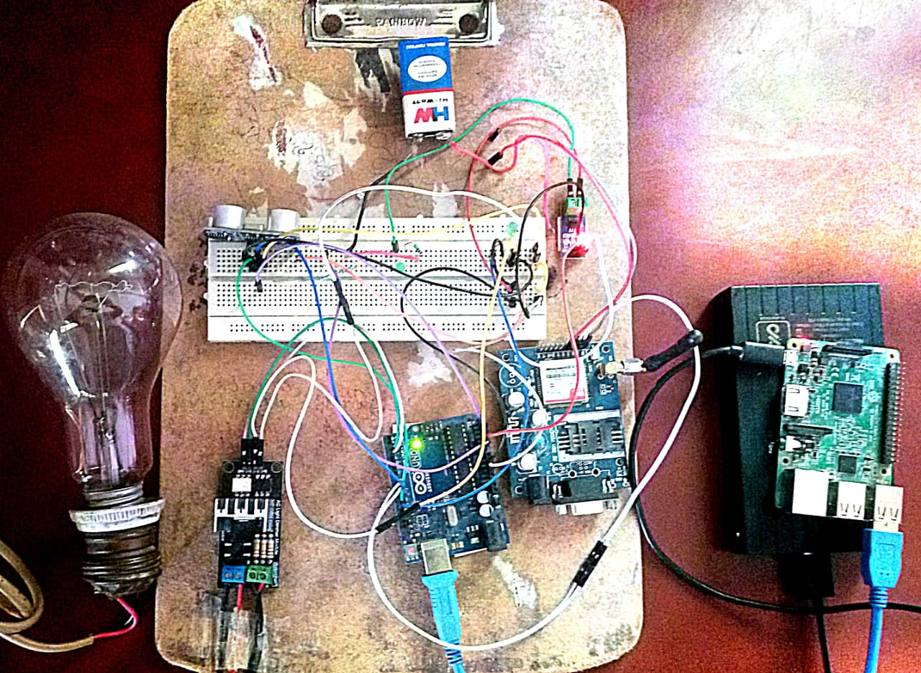
Hardware components
Arduino uno
Raspberry pi
LM 35 (Temperature sensor)
ACS712 (Current sensor)
Voltage divider circuit
HC-SR04 (Ultrasonic sensor)
AC Light dimmer module
GSM module

Slide 11

Challenges
Sensor malfunctioning which might lead to device damage.
Limited number of slots in Microcontrollers.
Unavailability of safe Ac power supply in House to work on project.
Delay in action between website and actuator.
Debugging gets challenging when we integrate arduino and raspberry pi.

Slide 12

Future scope
Extension of Real life applications to AC, Water Pump etc.
Using Paid web hosting service to buy domain name.
Adding more security & other features in the website.
Improved Quality of sensors for long maintenance & daily use.
Integrating smart home features in to system.

Slide 13
References
How to Connect a Raspberry Pi to a Laptop Display | Headless Setup link
How to Create a Windows 7 Bootable Windows SD Card or Flash Drive link
2-Way Communication Between Raspberry Pi and Arduino link
The naivest Way to Send and Retrieve Data from Cloud link
Udemy - Raspberry Pi For Beginners - 2020 Complete Course link

Slide 14
Link to previous work
Mid evaluation 1 presentation
6 Semester end evaluation presentation
6 Semester end evaluation Report
Mid evaluation 2 presentation

Slide 15
Thankyou.
Contact e-mails:
sai jyothi kumar
charan reddy
Any Questions?

